Slide 1
Mini project

Slide 2
YouTube downloader
Theertha PS, Milan, Amjadh, Fahad NAjeeb

Slide 3
Introduction
PyTube-powered YouTube downloader with a user-friendly and a simple interface, changing the way you save and organize your favorite videos. Embrace convenience and elevate your multimedia experience. We used tkinter as the User Interface window used to paste the link of the desired video and and progess bar for current download information

Slide 4
objective
Our objective for this college project is to develop a PyTube-powered YouTube downloader with a streamlined user interface, enabling users to effortlessly save and manage their preferred videos. We aim to enhance convenience and optimize the multimedia experience without creating a hassle on depending any third party services compromising privacy and safety

Slide 5
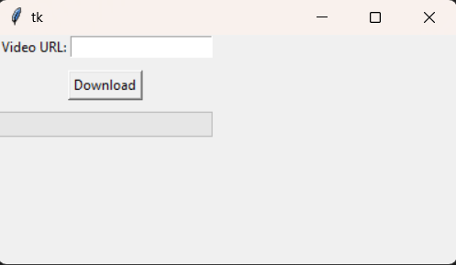
Features and UI
We provide a simple functional and lightweight user interface which creates no confusion and requires only python and the PyTube library installed on your client.
Interactive progress bar. Entire code fits under 2KB.

Slide 6
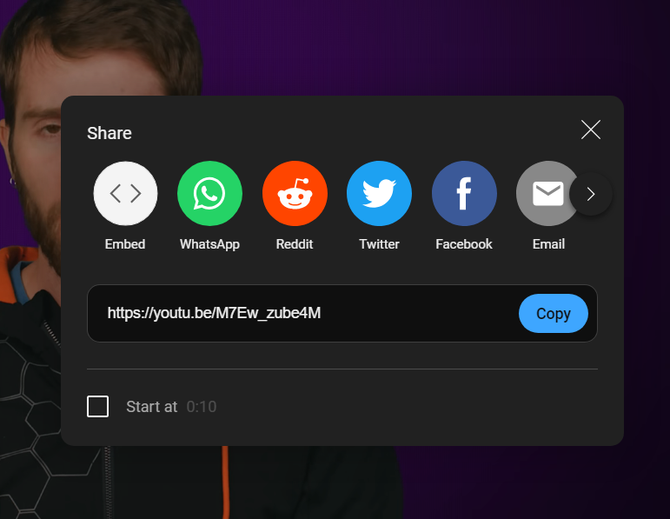
Copying the link
Go the desired YouTube video and copy the video link .

Slide 7
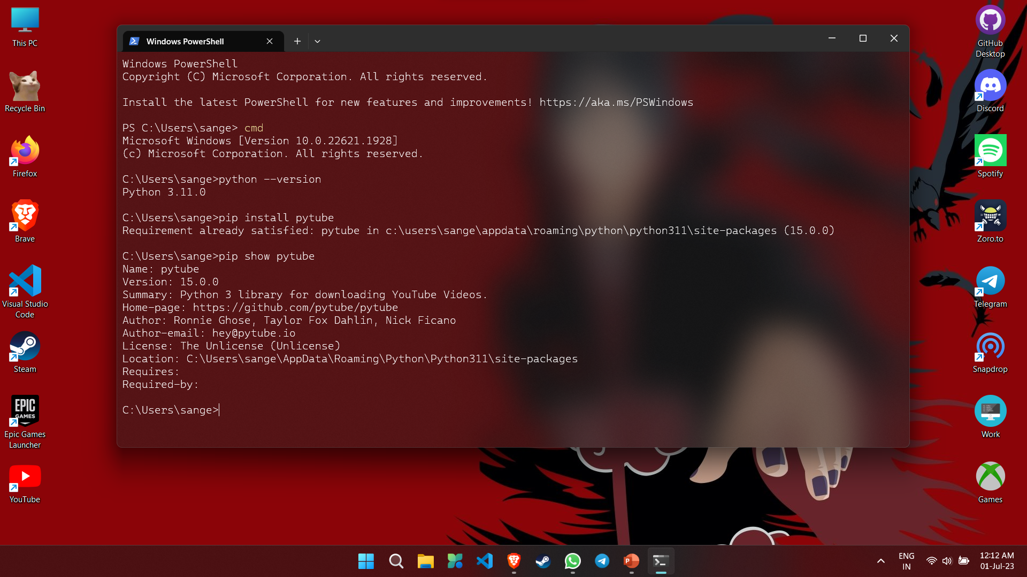
Setup PyTube library and run the app
Run `pip install pytube` in a command prompt windows in windows.
Use terminal in Linux based operating system and use the command `pip install pytube`

Slide 8
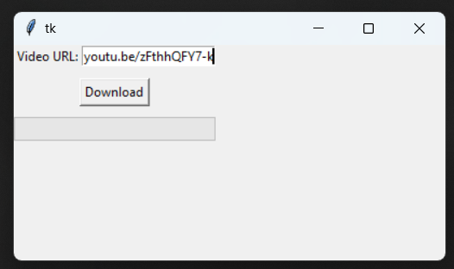
Run the program and download the video
Run the youtube_downloader.py Paste the link in the tk window pop up box.
Click on download and wait for the progress to finish. The downloaded file will be stored in the same directory the where the youtube_downloader.py file is placed.

Slide 9
Technologies
Python 3.11
Pytube
Tkinter
Tkinter.tk

Slide 10
Code
import os
import tkinter as tk
from tkinter import ttk
from tkinter.ttk import Progressbar
import pytube
#Creating class for the UI
class App(tk.Tk):
def __init__(self):
super().__init__() self.video_url = tk.StringVar()

Slide 11
# Create the UI elements
self.video_url_label = tk.Label(self, text="Video URL:")
self.video_url_entry = tk.Entry(self, textvariable=self.video_url)
self.download_button = tk.Button(
self, text="Download", command=self.download_video
)
self.progress_bar = Progressbar(self, mode="determinate")

Slide 13
# Layout the UI elements
self.video_url_label.grid(row=0, column=0)
self.video_url_entry.grid(row=0, column=1)
self.download_button.grid(row=1, column=0, columnspan=2, pady=10)
self.progress_bar.grid(row=2, column=0, columnspan=2, sticky="we")
# Set the window size
self.geometry("400x200")

Slide 14
#Video Download Function When The Buttom is Clicked
def download_video(self):
# Get the video URL from the user
video_url = self.video_url.get()
# Default download path to current directory
download_path = os.getcwd()
# Download the video
try:
video = pytube.YouTube(video_url)
stream = video.streams.get_highest_resolution()
if stream:
stream.download(output_path=download_path)
print("Download completed!")
else:
print("No video available")
except Exception as e:
print(e)

Slide 15
if __name__ == "__main__":
app = App()
app.mainloop()

Slide 16
Advantages
Lightweight. Entire code fits in 55 lines.
Platform independent. Runs anywhere. Literally
Easy to understand and uses open source lib like tkinder and pytube.
No ads, easy to run fast and efficient.
Code is written in a way for people to customize, improve, adapt to specifc needs and upgradation in the future.

Slide 17
DISAdvantages
tkinder UI looks outdated and a bit finicky.
Lack of customization in configuring the downloads.
User still needs to setup python and pytube library.
Sudden breaking API changes to YouTube videos could make the current version of pytube and user will need to wait till pytube releases and update

Slide 18
Thank you

